Slide 1









STUDENT DETAILS
Name: Akash Pal
Email Id: connect.akashpal@gmail.com
College Name: University Institute of Technology, Burdwan
College State: West Bengal
Internship Domain: Artificial Intelligence
Internship Start Date & End Date:
18 Aug 2023 to 30 Sep 2023

Slide 2



SENTIMENT ANALYSIS OF RESTAURANT REVIEWS
In today's world, social media wields significant influence in both personal and professional spheres, prompting individuals to base decisions on their online observations. This trend has substantial implications for businesses. Consequently, industries are actively seeking strategies to analyze and interpret data derived from social media, blogs, and various online platforms. A valuable method involves scrutinizing user sentiment through their internet reviews. As a response to this need, we are in the process of developing an AI algorithm designed to detect user sentiment based on their reviews.

Slide 3

AGENDA
In our increasingly internet-driven world, the need to extract valuable insights from the vast expanse of online data has become paramount. Businesses, such as restaurants, can harness this data to evaluate their performance and gain a deeper understanding of customer sentiment. Our objective is to develop an AI algorithm capable of discerning user sentiment from their reviews, categorizing them as either positive or negative. This valuable tool empowers restaurants to glean insights, identify top-performing dishes, address areas for improvement, and address negative feedback, ultimately enabling them to enhance their performance and better serve their customers.

Slide 4
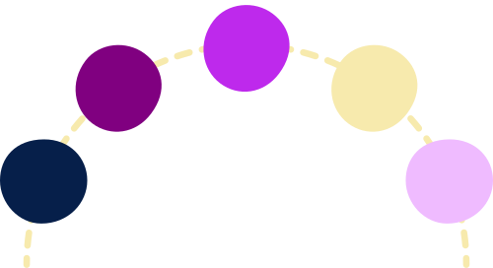
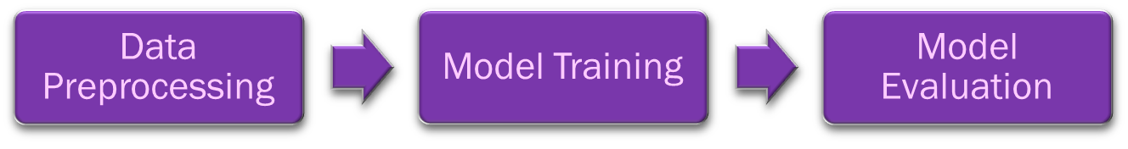
PROJECT OVERVIEW
This project seeks to automate the analysis of restaurant reviews, offering a time-efficient solution for potential customers. It involves creating a sentiment analysis model that categorizes reviews as positive, negative, or neutral through supervised machine learning. Evaluation metrics include accuracy, precision, and recall. This initiative benefits both restaurant owners and customers, aiding owners in improving service or food quality while helping customers find suitable restaurants effortlessly. The project will be completed in three phases:

Slide 5



USERS
The users of the sentiment analysis of restaurant reviews project are:
• Restaurant owners: Restaurant owners can use the model to identify areas where they can improve their service or food quality. For example, if the model identifies that many negative reviews mention slow service, the restaurant owner can take steps to improve the speed of service.
• Customers: Customers can use the model to quickly and easily find restaurants that are likely to meet their needs. For example, if a customer is looking for a restaurant with good food, they can use the model to find restaurants that have mostly positive reviews.
Here is one examples of how the project can help users:
The model assists restaurant owners in pinpointing popular dishes and areas for improvement, guiding menu updates and preparation adjustments.
The model aids customers in discovering restaurants with ample vegetarian or vegan choices, catering to those with dietary limitations.

Slide 6



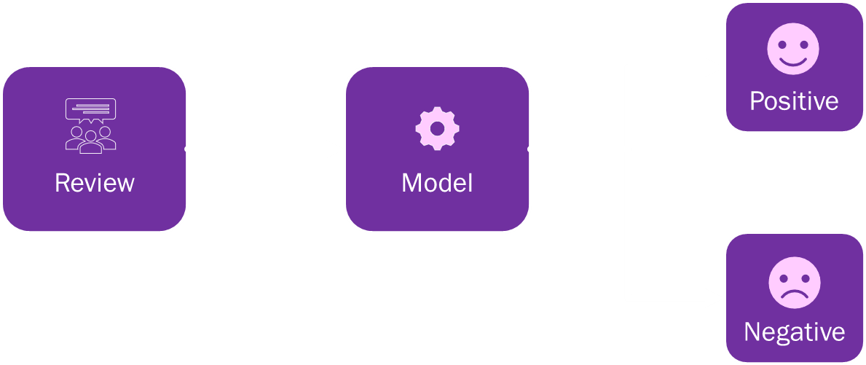


SOLUTION
Our solution incorporates a classification model enabling users to determine the sentiment (positive or negative) of reviews. Users input one or multiple reviews, and the system promptly delivers accurate sentiment analysis results. These outputs empower users to assess restaurant performance, pinpoint areas for enhancement, and gain insights into customer expectations for informed decision-making.

Slide 7
WOW IN SYSTEM
•Accurate results
•Accurate classification
•Higher accuracy
•Flexible
•Scalable

Slide 8
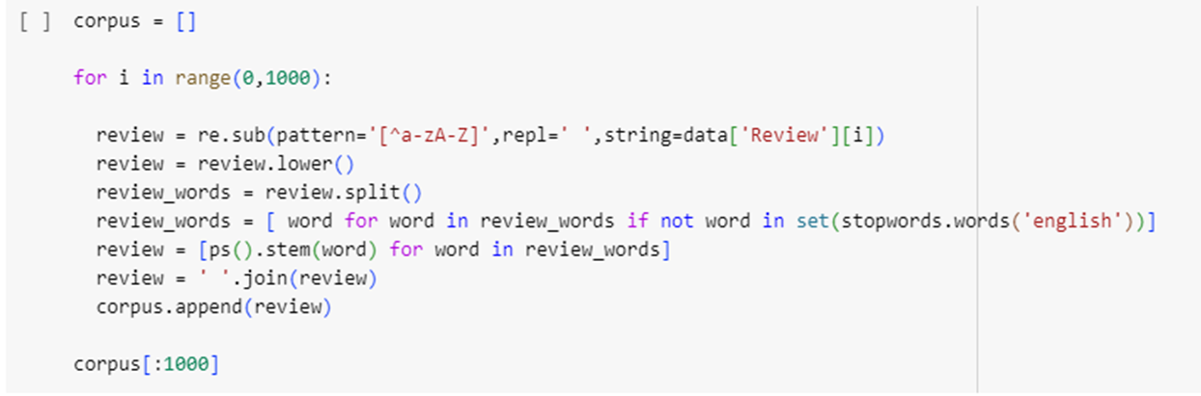
MODELLING
The algorithm was developed in four stages :
1. Data Cleaning : Prior to model training, data must undergo essential cleaning processes. This includes formatting data correctly for training, eliminating blanks, and removing extraneous information. In this scenario, we prioritize removing stopwords—words that do not contribute to sentence meaning—before commencing model training.

Slide 9
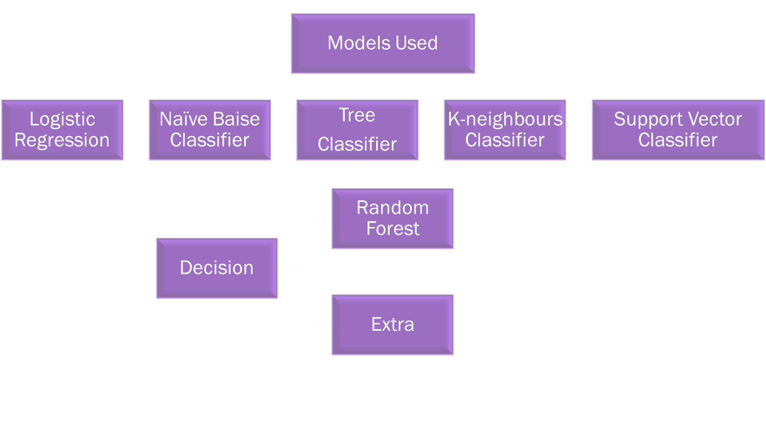
MODELLING

Slide 10
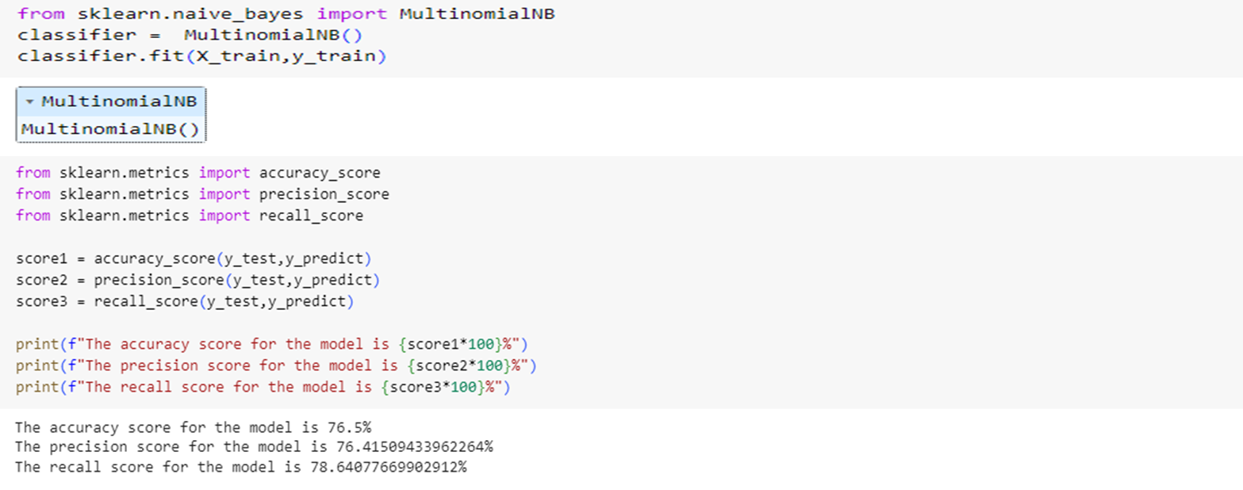
MODELLING
2. Model Training & Evaluation : Following data cleaning, the model undergoes training. We split the training corpus into 70% for model training and 30% for testing. Once training concludes, we assess the model's performance using accuracy, precision, and recall as key evaluation parameters.

Slide 11
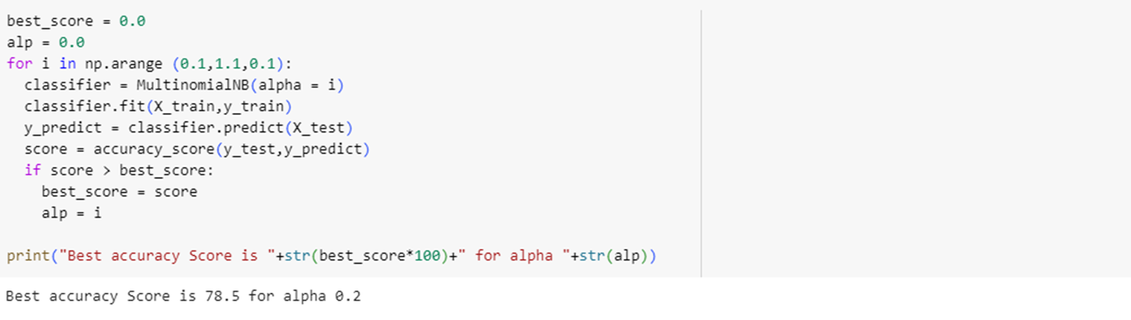
MODELLING
3. Hyperparameter Tuning : After training we have to tune the hyperparameter to find the best model.

Slide 12
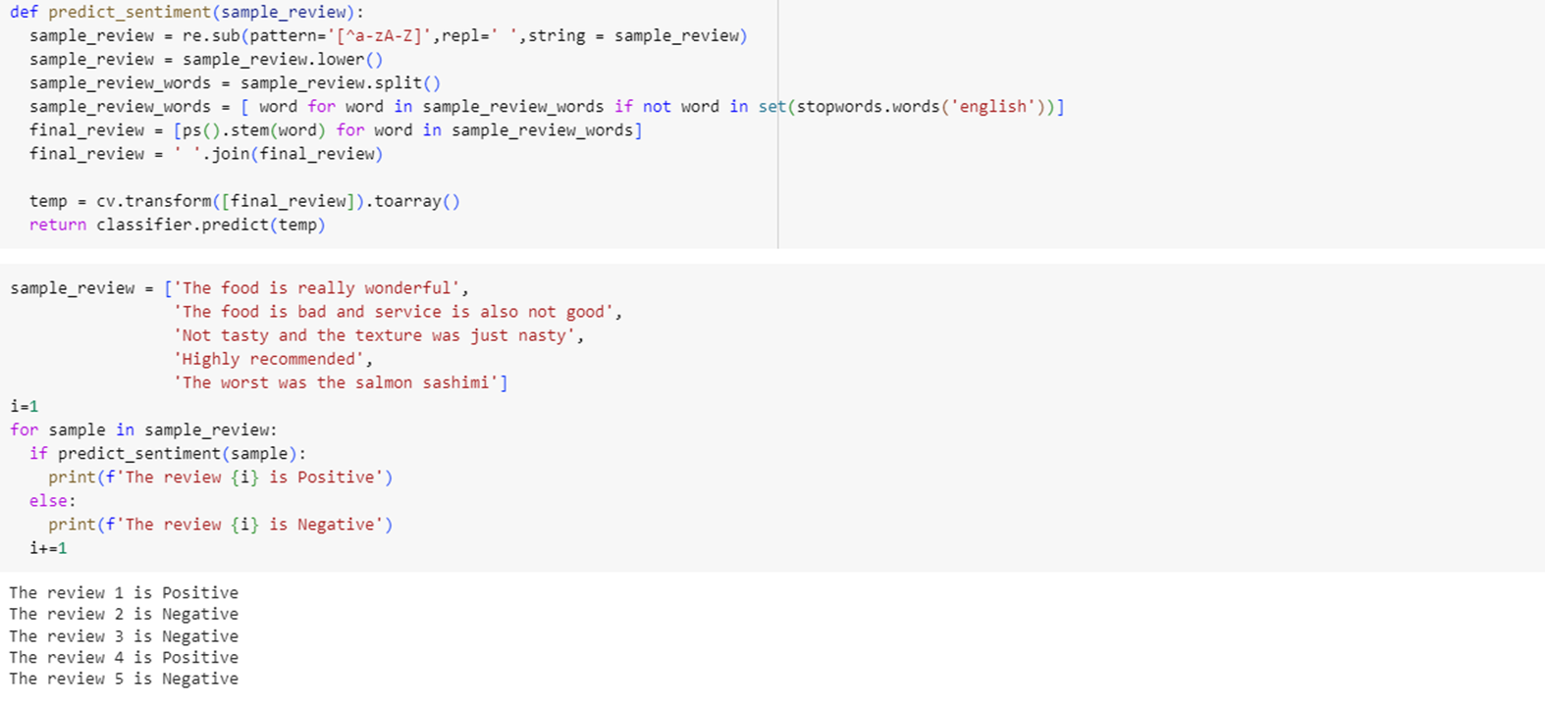
MODELLING
4. Model Testing : Testing the model with five different inputs.

Slide 13
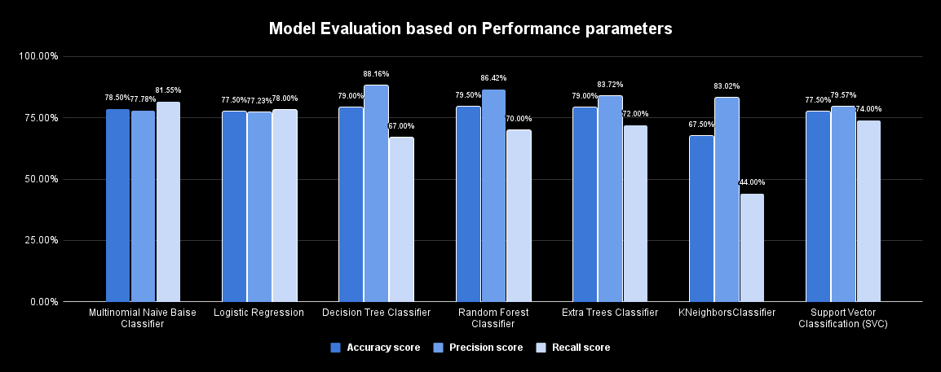
MODEL PERFORMANCE

Slide 14

RESULTS
Random Forest Classifier Algorithm is the best algorithm amongst all the algorithm used for this dataset with the highest accuracy score of 79.50%.
The model was accurate to predict the results for different inputs.
K-Neighbours Classifier Algorithm is the worst algorithm amongst all the algorithm used for this dataset with the lowest accuracy score of 67.50%.

Slide 15



LINKS
GOOGLE
COLLAB
GITHUB
*Click on shape to open link

Slide 16


